Slide 1

Connected Vehicles and CCAV
Ella Taylor

Slide 2
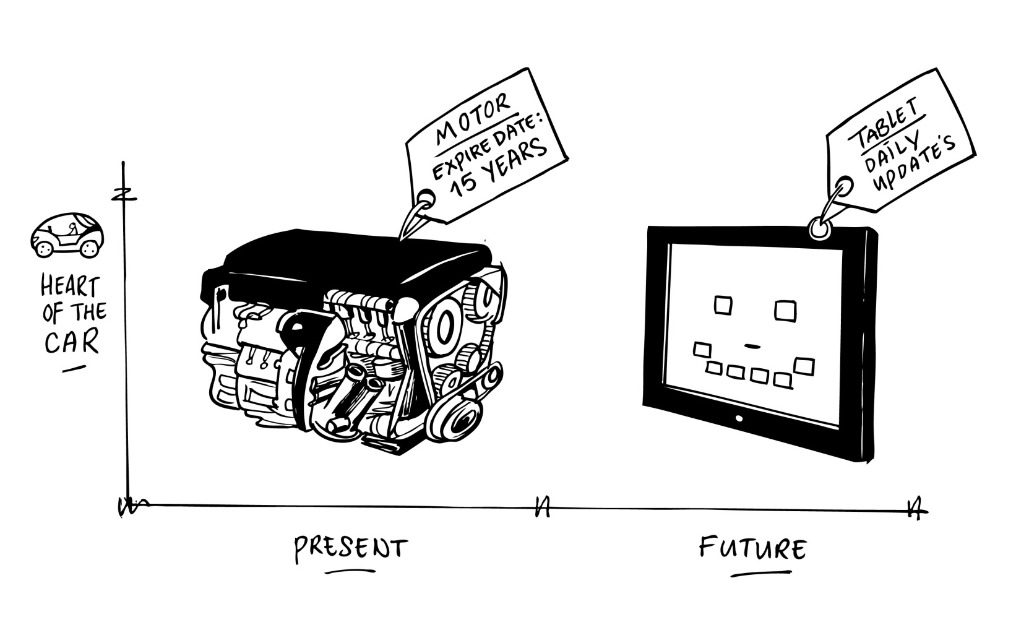

Slide 3
safety
efficiency
mobility
productivity

Slide 4
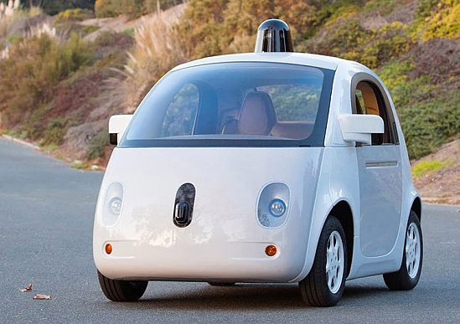
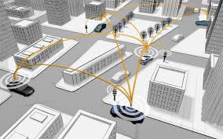
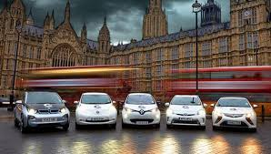
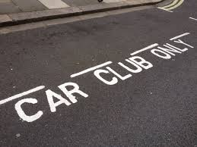

Slide 5
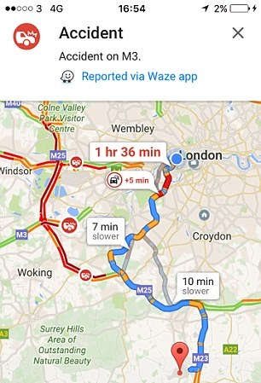
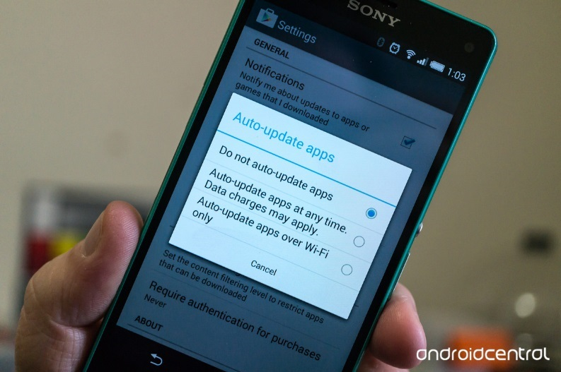
At home, planning your journey
On your journey, making strategic decisions

Slide 6
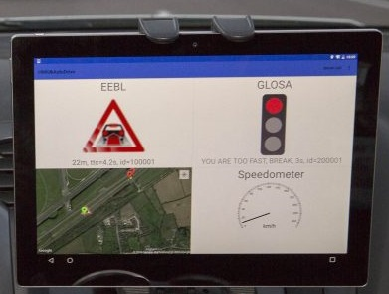
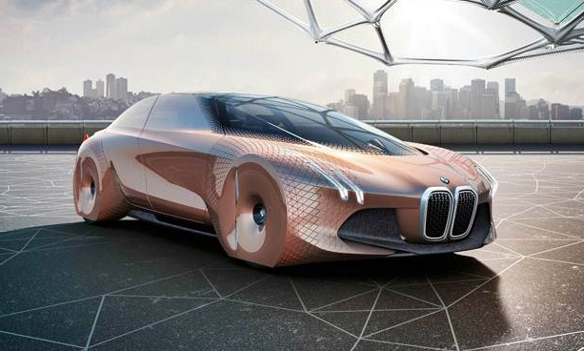
On your journey, but your vehicle is deciding
On your journey, making tactical decisions

Slide 7
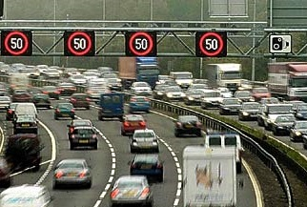
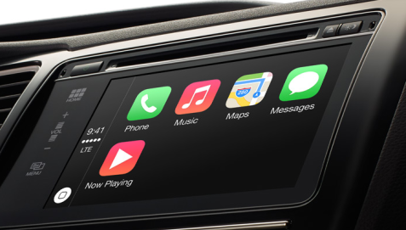
The system is making decisions
Enjoying entertainment services

Slide 8
Communication Methods
Data ownership and platforms
Standards
Research and Development
Security

Slide 9
Consumer Choices
Human Machine Interface
Societal Impacts
Interoperability
Skills

Slide 10



Office for Low Emission Vehicles
DCMS
International Vehicle Standards
Automotive Unit
Chief Scientific Advisor
UKTI
Road User Licensing Insurance & Safety
Strategy Unit
Traffic
Research Base
GO SCIENCE

Slide 11
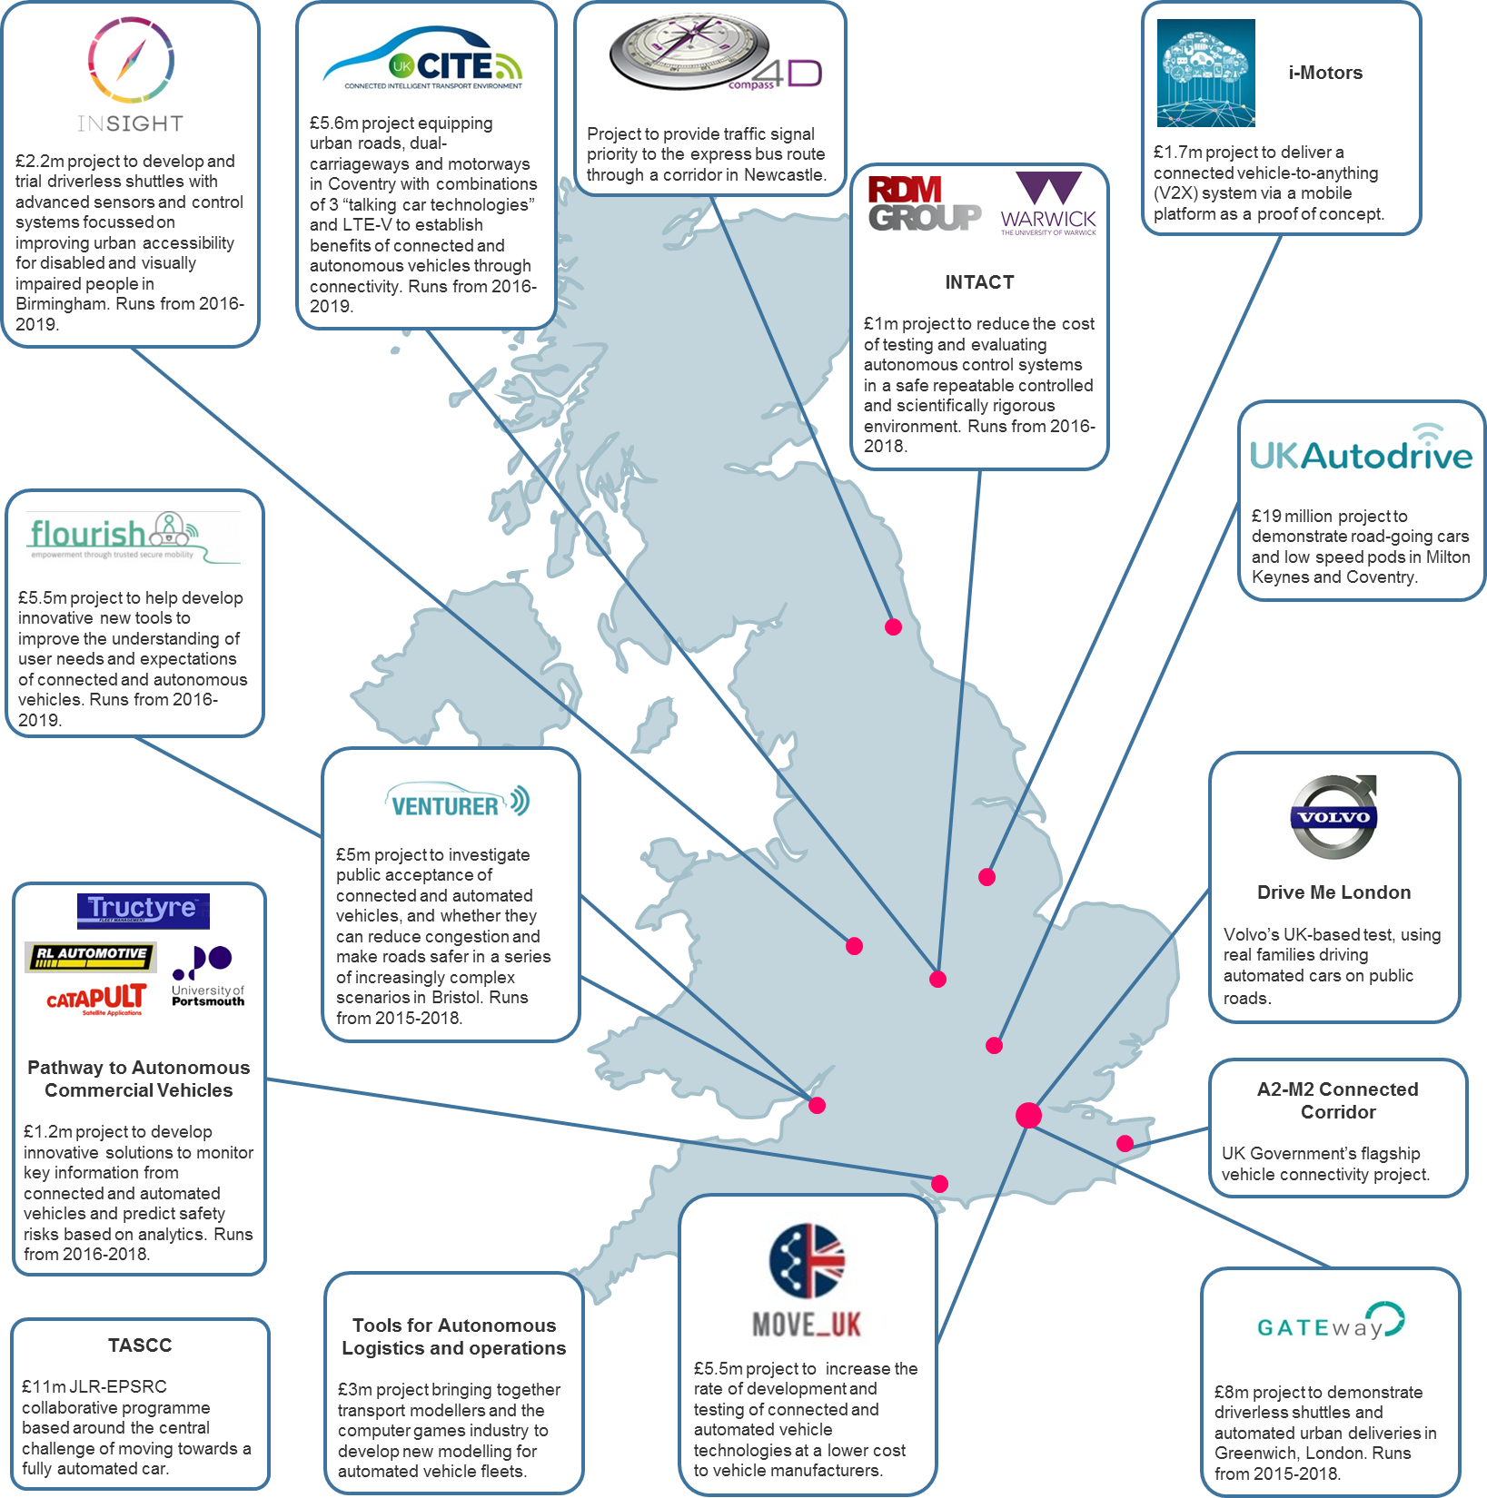

Slide 13
Thanks!
Ella.Taylor@ccav.gov.uk

